Slide 1

CHAPTER 4: Functions
Amni Saizan

Slide 2

Stored (and reused) Steps
def thing():
print('Hello')
print('Fun')
thing()
print('Zip')
thing()
def
hello():
Program:
def thing():
print('Hello')
print('Fun')
thing()
print('Zip')
thing()
print 'Hello'
Output:
Hello
Fun
Zip
Hello
Fun
print 'Fun'
hello()
print “Zip”
hello()
We call these reusable pieces of code “functions”.

Slide 3
Python Functions
There are two kinds of functions in Python.
  Built-in functions that are provided as part of Python - input(), type(), float(), int() ...
  Functions that we define ourselves and then use
We treat the of the built-in function names as "new" reserved words (i.e. we avoid them as variable names)

Slide 4
Function Definition
In Python a function is some reusable code that takes arguments(s) as input does some computation and then returns a result or results
We define a function using the def reserved word
We call/invoke the function by using the function name, parenthesis and arguments in an expression

Slide 5
Argument
big = max('Hello world')
Assignment
'w'
Result
>>> big = max('Hello world')
>>> print big
W
>>> tiny = min('Hello world')
>>> print tiny
>>>
Notes:
# symbol no hurufbesar hurufkecil

Slide 6
Type Conversions
m=(float(99) / 100)
print (m)
print(type(m))
i = 42
print(type(i))
f = float(i)
print (f)
print(type(f))
print (1 + 2 * float(3) / 4-5)
When you put an integer and floating point in an expression the integer is implicitly converted to a float
You can control this with the built in functions int() and float()
0.99
<class 'float'>
<class 'int'>
42.0
<class 'float'>
-2.5

Slide 7
String Conversions
>>> sval = '123'
>>> type(sval)
<type 'str'>
>>> print sval + 1
Traceback (most recent call last):
File "<stdin>", line 1, in <module>
TypeError: cannot concatenate 'str' and 'int'
>>> ival = int(sval)
>>> type(ival)
<type 'int'>
>>> print ival + 1
124
>>> nsv = 'hello bob'
>>> niv = int(nsv)
Traceback (most recent call last):
File "<stdin>", line 1, in <module>
ValueError: invalid literal for int()
You can also use int() and float() to convert between strings and integers
You will get an error if the string does not contain numeric characters

Slide 8
Building our Own Functions
We create a new function using the def keyword followed by optional parameters in parenthesis.
We indent the body of the function
This defines the function but does not execute the body of the function
def print_lyrics():
print "I'm a lumberjack, and I'm okay.”
print 'I sleep all night and I work all day.'

Slide 9
Definitions and Uses
Once we have defined a function, we can call (or invoke) it as many times as we like
This is the store and reuse pattern

Slide 10
x = 5
print 'Hello'
def print_lyrics():
print "I'm a lumberjack, and I'm okay.”
print 'I sleep all night and I work all day.'
print 'Yo'
print_lyrics()
x = x + 2
print x
Hello
Yo
I'm a lumberjack, and I'm okay.I sleep all night and I work all day.
7

Slide 11
Arguments
An argument is a value we pass into the function as its input when we call the function
We use arguments so we can direct the function to do different kinds of work when we call it at different times
We put the arguments in parenthesis after the name of the function
big = max('Hello world')
Argument

Slide 12
Parameters
def greet(lang):
if lang == 'es':
print ('Hola')
elif lang == 'fr':
print ('Bonjour')
else:
print ('Hello')
greet ('es')
greet ('en')
greet ('fr')
A parameter is a variable which we use in the function definition that is a “handle” that allows the code in the function to access the arguments for a particular function invocation.
Hola
Hello
Bonjour
Hola
Hello
Bonjour

Slide 13
Return Values
Often a function will take its arguments, do some computation and return a value to be used as the value of the function call in the calling expression. The return keyword is used for this.
def greet():
return "Hello"
print (greet(), "Glenn")
print (greet(), "Sally")
Hello Glenn
Hello Sally

Slide 14
Return Value
def greet(lang):
if lang == 'es':
return 'Hola'
elif lang == 'fr':
return 'Bonjour'
else:
return 'Hello'
print (greet('en'),'Glenn')
print (greet('es'),'Sally')
print (greet('fr'),'Michael')
A “fruitful” function is one that produces a result (or return value)
The return statement ends the function execution and “sends back” the result of the function
Hello Glenn
Hola Sally
Bonjour Michael

Slide 15
Multiple Parameters / Arguments
We can define more than one parameter in the function definition
We simply add more arguments when we call the function
We match the number and order of arguments and parameters
def addtwo(a, b):
added = a + b
return added
x = addtwo(3, 5)
print x

Slide 16
Void (non-fruitful) Functions
When a function does not return a value, we call it a "void" function
Functions that return values are "fruitful" functions
Void functions are "not fruitful"

Slide 17
To function or not to function...
Organize your code into “paragraphs” - capture a complete thought and “name it”
Don’t repeat yourself - make it work once and then reuse it
If something gets too long or complex, break up logical chunks and put those chunks in functions
Make a library of common stuff that you do over and over - perhaps share this with your friends...

Slide 18
Task 1
Rewrite your pay computation to give the employee for normal time working is 5 and for overtime is 10 for hourly rate for hours worked above 40 hours. Create functions for normal and overtime.
Entered Hours: 45
Pay: ?
Normal rate = 5
Overtime rate = 10
Pay = hours * rate

Slide 19
Task 4
Create function:
add().
minus()
multiply()
divide()
Get input from user. Use the input to perform all these functions

Slide 20
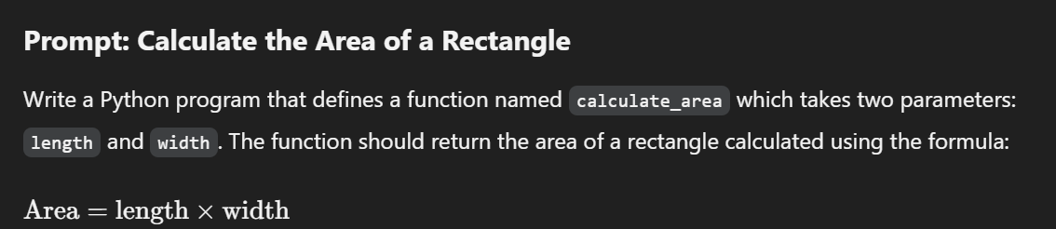
Task 5

Slide 21
Task 6
Write a program to create function func1() to accept a variable length of arguments and print their value.
Example:
  func1(20,60,30)
  Printing values:
  20
  60
  30

Slide 22
Task 7
Write a program to create function calculation() such that it can accept two variables and calculate addition and subtraction. Also, it must return both addition and subtraction in a single return call.

Slide 23
Task 8
Write a program to create a function show_employee() using the following conditions:
  It should accept the employee’s name and salary and display both.
  If salary is missing in the function call then assign default value 9000 to salary.

Slide 24
Summary
Functions
Built-In Functions
  Type conversion (int, float)
  Math functions (sin, sqrt)
Try / except (again)
Arguments
Parameters

Slide 25
Reference
Python for Informatics: Exploring Information
www.pythonlearn.com

